Slide 1

Predicting the Health care Insurance costs
(Team 2)
Jitesh Bhavsar
Pranay Joshi
Venkat Naren
Asra Munawar
Poorvi Suhane
This Photo by Unknown author is licensed under CC BY-ND.

Slide 2

Healthcare Insurance
Healthcare Insurance Business and Involvement of Data Science
This Photo by Unknown author is licensed under CC BY-NC-ND.

Slide 3
Top 10 Private health Insurances in USA
1.United Health
2.Kaiser Foundation
3.Anthem, Inc
4.Centene Corp
5.Humana
6.CVS
7.HCSC
8.Cigna Health
9.Molina Healthcare
10.Independence Health group

Slide 4

Problem statement
The problem of insurance companies earning insufficient revenues from people's health care spending can be remedied by developing models that use linear regression to properly calculate health costs.

Slide 5
Data Set- Variables
● Age
● SeX
● BMI
● Smoker StatuS
● Children
● RegioN of residenCE
● Charges

Slide 6

Analysis Performed
Preprocessing
Exploratory Data Analysis
Hypothesis testing
Multiple linear Regression

Slide 7

Insurance
Insurance is something that protects you against the possibility of anything bad happening.

Slide 8

Analysis

Slide 9
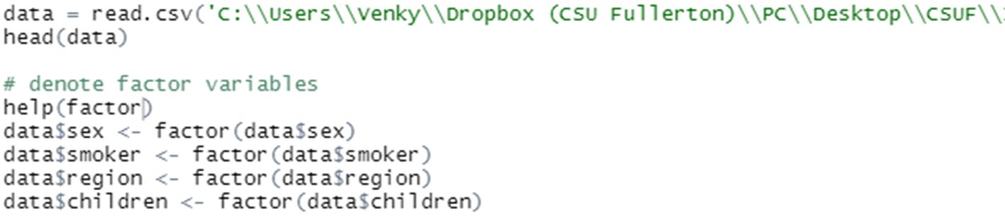
Reading Data and factoring variables

Slide 10
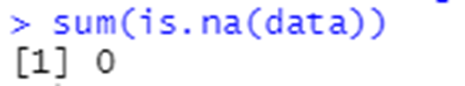
Checking missing values
As per our analysis, there are no missing values.

Slide 11
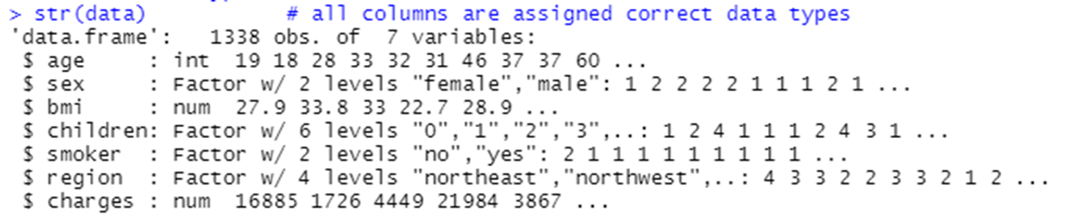
Checking Data Types

Slide 12
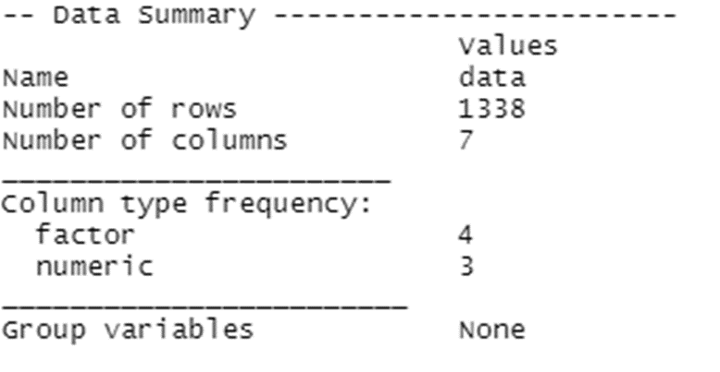
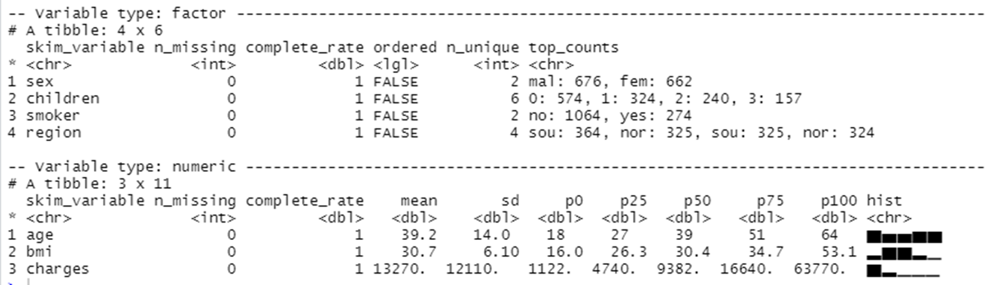
Using skim function for summary

Slide 13
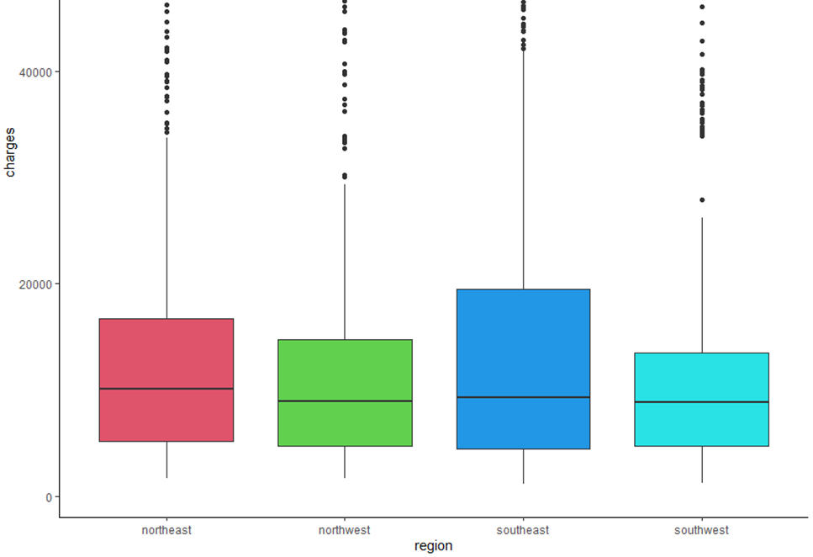
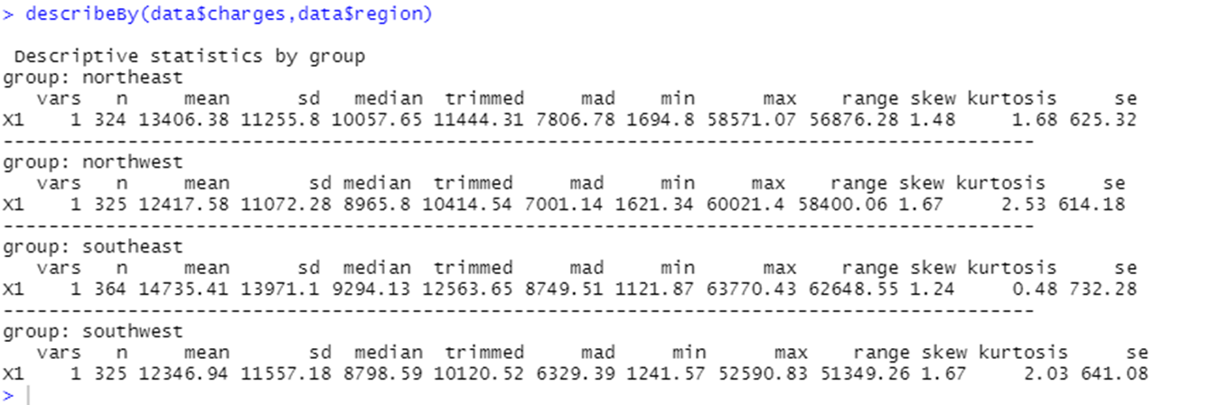
Medical Charges per region

Slide 14
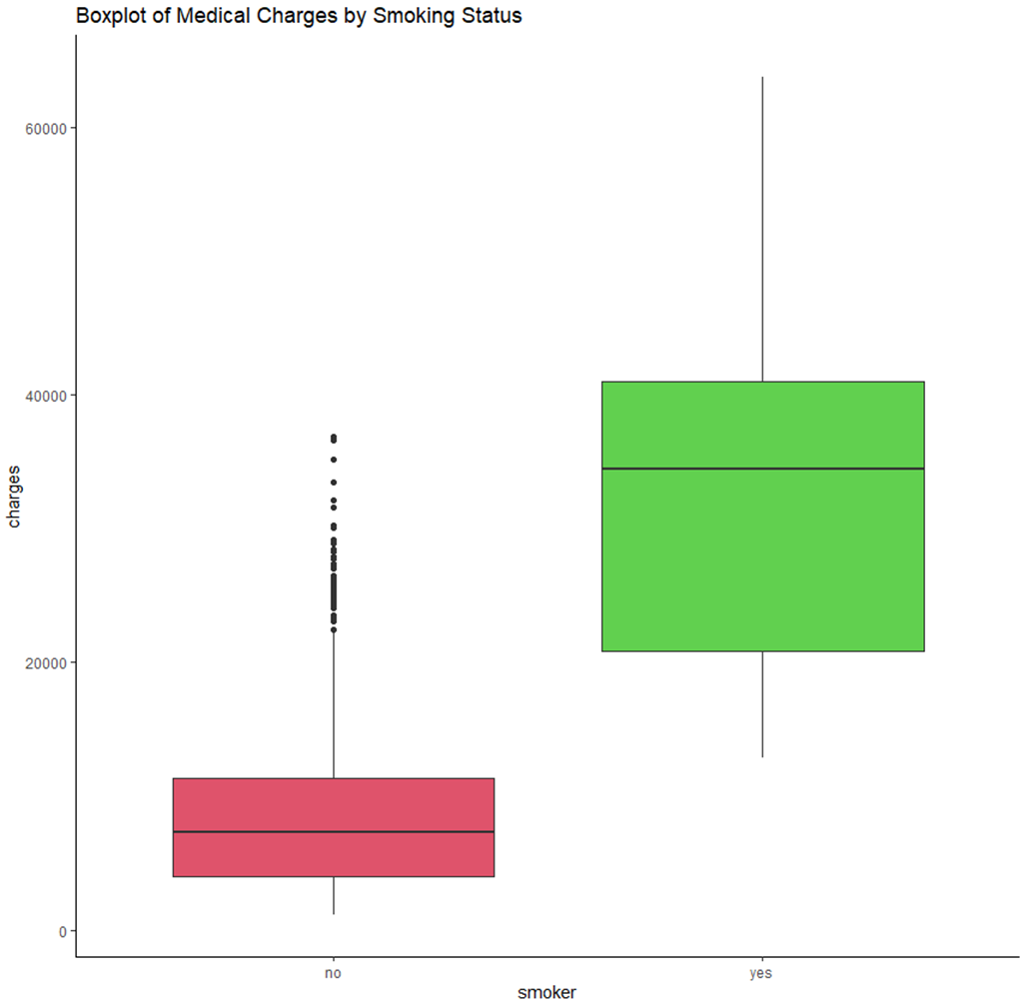
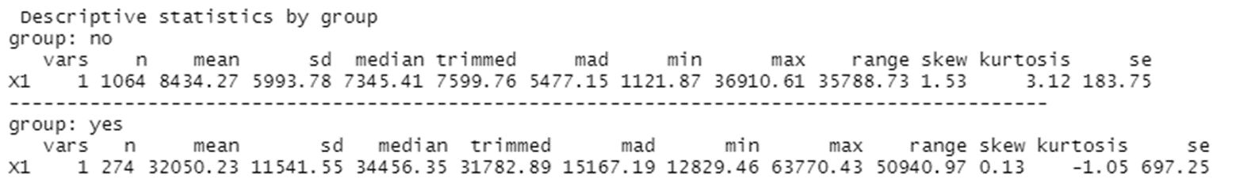
Boxplot of Medical Charges as per smoking status

Slide 15
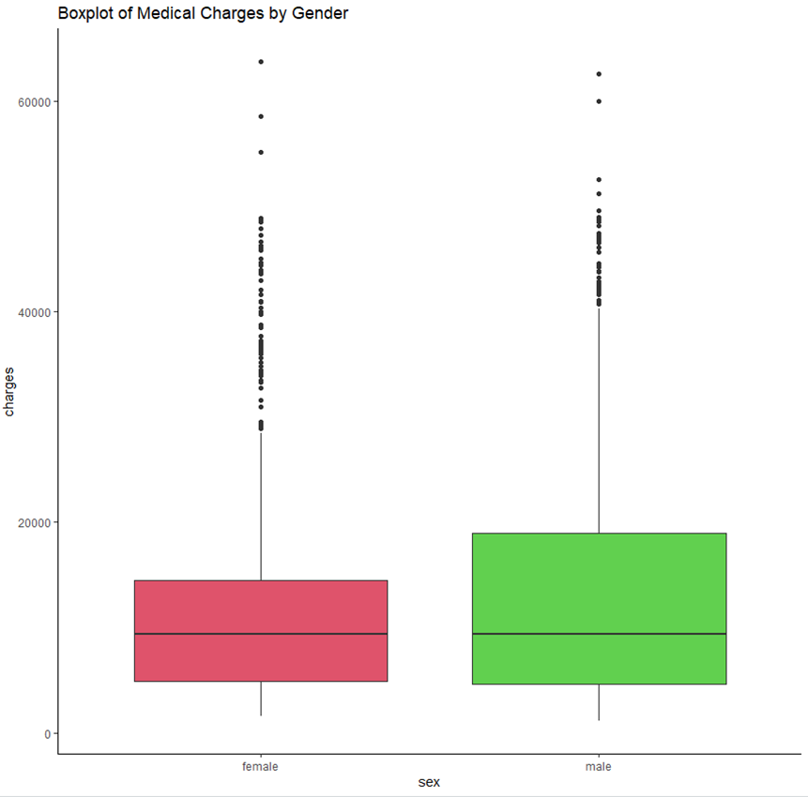
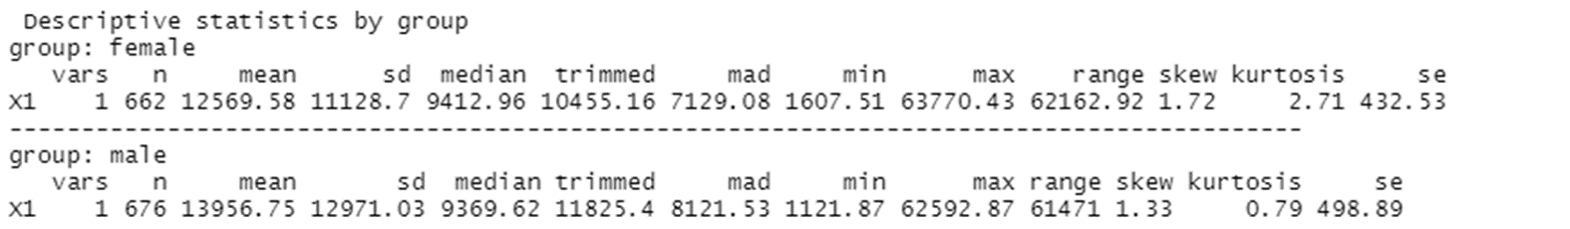
Boxplot of Medical Charges versus Gender

Slide 16
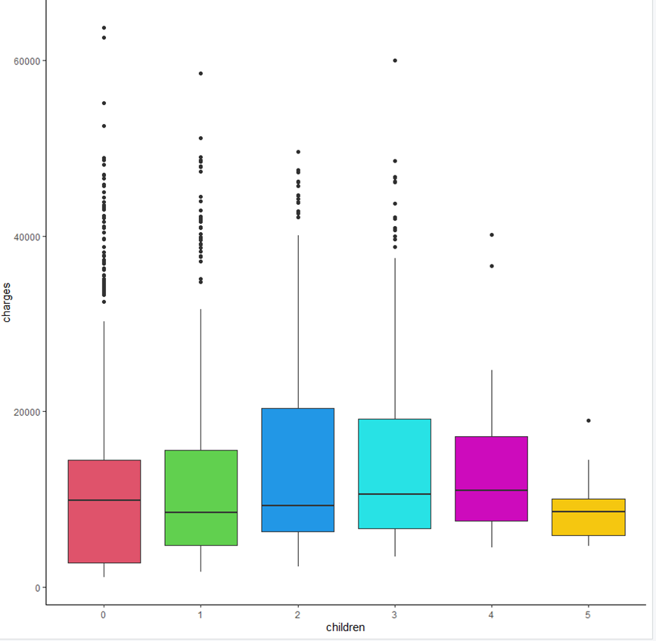
Medical Charges by Number of Children

Slide 17
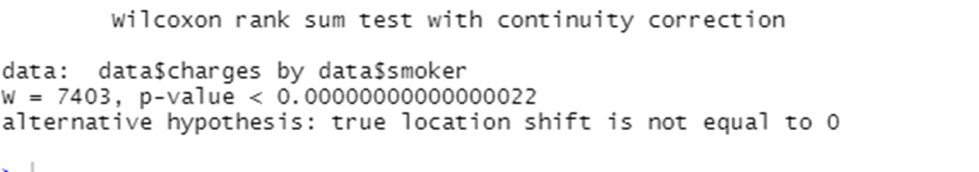
Hypothesis Testing (Smoking)
Smoking
EDA has indicated that smoking has an effect on charges

Slide 18
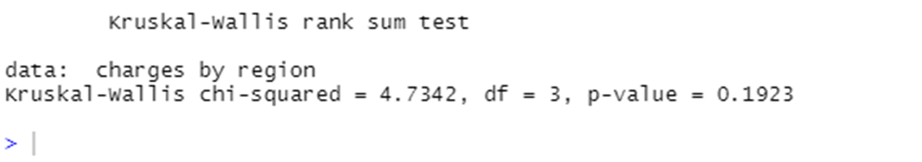
Hypothesis Testing (Region)
There was also some difference in medical charges between regions
#H0: There is no difference between the medians.
#HA: There is a difference between the medians.
#The test showed that the difference between the median medical charges in different regions is not significant, H(3) = 4.73, p = 0.19. A significant level of 0.19 indicates a 19% risk of concluding that a difference exists when there is no actual difference. The null hypothesis is accepted.

Slide 19
Train Test Split
Determine row to split on: split
split <- round(nrow(data)*0.80)
Create train
train <- data[1:split, ]
Create test
test <- data[(split + 1):nrow(data), ]

Slide 20
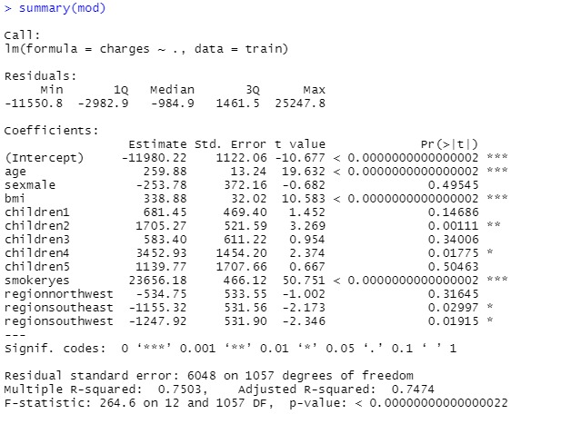
Model Building
The model explains 75% variance, which is good based on the data.

Slide 21
Output Continuation
# Train RMSE
sqrt(mean((train$charges - predict(mod, train)) ^ 2))
RMSE = 6010.902
error = test$charges - p
# Test RMSE
RMSE <- sqrt(mean(error^2))
RMSE = 6130.572

Slide 22

Thank You
Any Questions

